Slide 1

Web Application
MERN
By
BJIT Academy
Image Placeholder

Slide 2
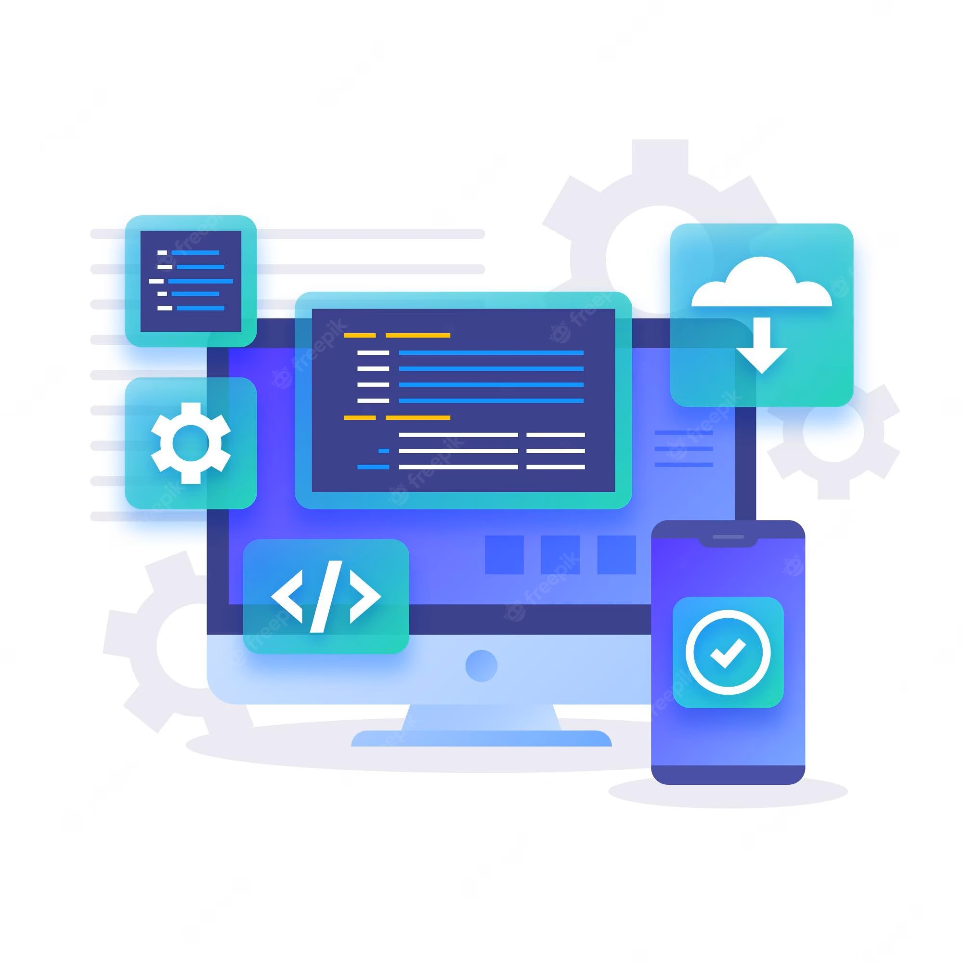
What is a Web Application?
A web application is software that runs in your web browser. Businesses have to exchange information and deliver services remotely.
They use web applications to connect with customers conveniently and securely. The most common website features like shopping carts, product search and filtering, instant messaging, and social media newsfeeds are web applications in their design.
They allow you to access complex functionality without installing or configuring software.

Slide 3
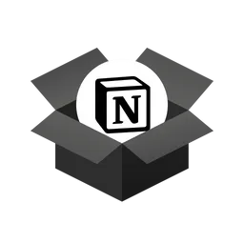

What are some common web applications?
Workplace collaboration web applications
Workplace collaboration web apps allow team members to access documents, shared calendars, business instant messaging services, and other enterprise tools.

Slide 4
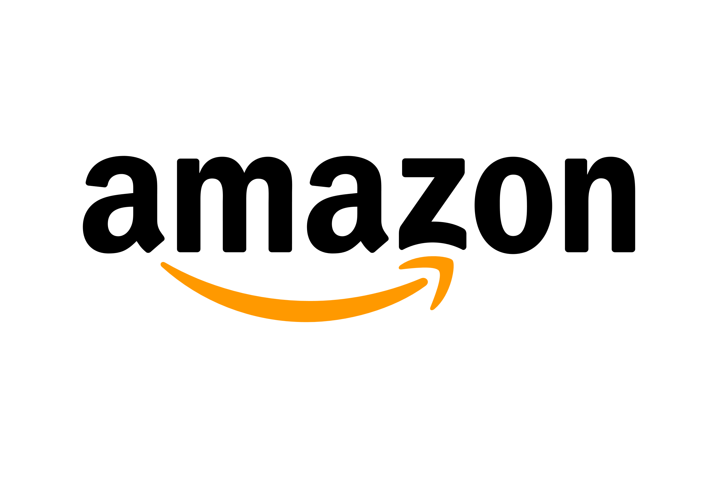
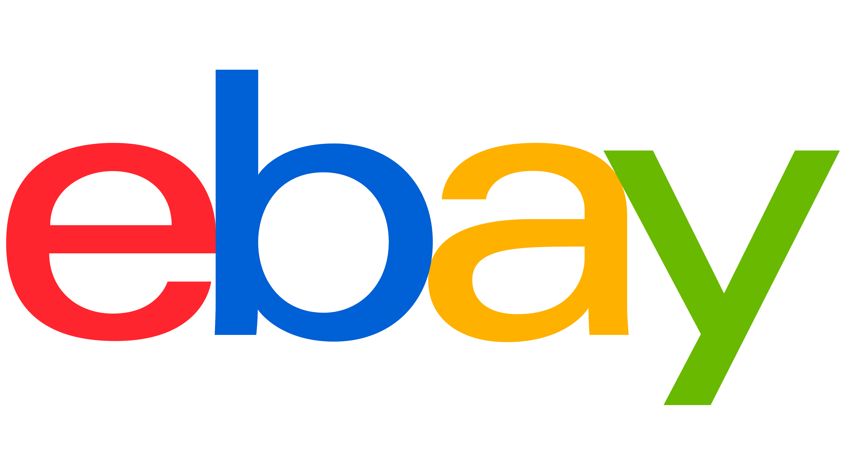
What are some common web applications?
Ecommerce web applications
Ecommerce web apps such as Amazon.com enable users to browse, search, and pay for products online.

Slide 5
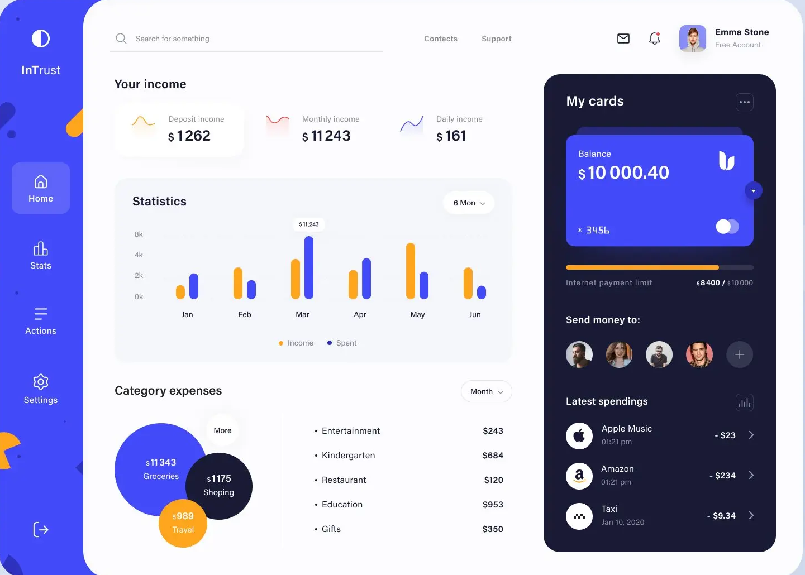
What are some common web applications?
Online banking web applications
Business and personal users widely use online banking web apps to access their accounts and other financial products such as loans and mortgages.

Slide 6
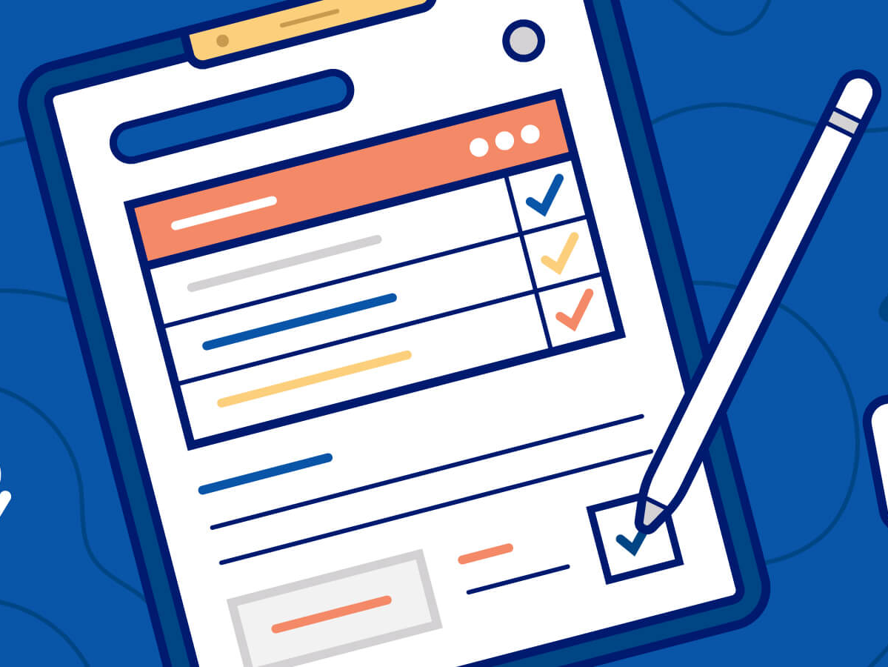
What are some common web applications?
Technical documentation
You can use web applications to create and share technical documentation like user manuals, how-to guides and device specifications

Slide 7

How do web applications work?
Client-Side Architecture
The client-side script deals with user interface functionality like buttons and drop-down boxes. When the end user clicks on the web app link, the web browser loads the client-side script and renders the graphic elements and text for user interaction.
For example, the user can read content, watch videos, or fill out details on a contact form. Actions like clicking the submit button go to the server as a client request.

Slide 8
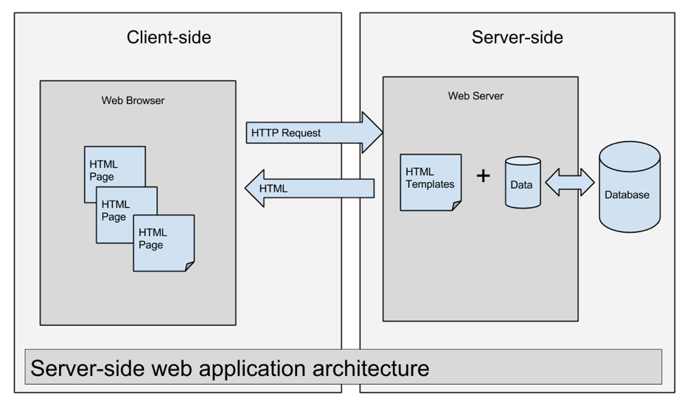
How do web applications work?
Server-Side Architecture
The server-side script deals with data processing. The web application server processes the client requests and sends back a response. The requests are usually for more data or to edit or save new data.
For example, if the user clicks on the Read More button, the web application server will send content back to the user. If the user clicks the Submit button, the application server will save the user data in the database.
In some cases, the server completes the data request and sends the complete HTML page back to the client. This is called server-side rendering.

Slide 9
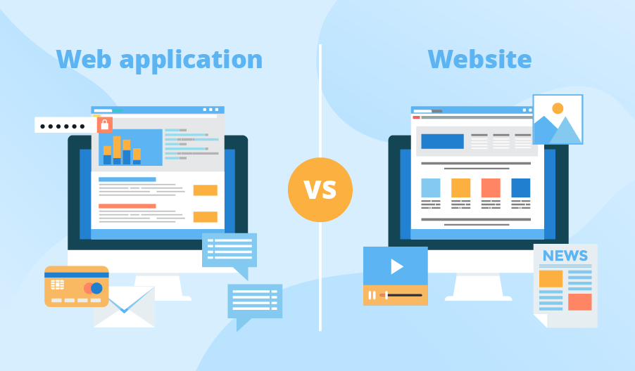
Difference between a web application and a website
When the internet was newly invented, websites had significantly less functionality than web apps. They were only capable of delivering information to users through static content.
You had to install and run software with complex functionality. Web apps were built to bridge the gap between software and static sites. They had functionality and interactive user elements like the software but were delivered using a web browser URL.
However, web technology has evolved significantly since then. Most modern websites are complex web applications in their design.

Slide 10
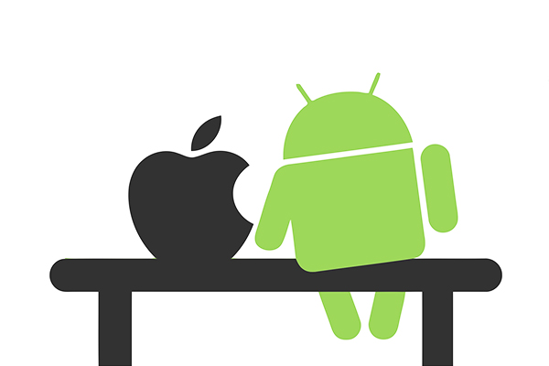
Difference between a web app and a native app
A native app is a computer program that has been specifically designed for a particular user environment. One of the most common types of native apps are mobile apps, which are developed using specific programming code.
Unlike web apps, native or mobile apps are downloaded by the user to their mobile device, usually through app stores. Native apps can only be accessed on the device they have been downloaded on, and users are responsible for downloading any updates.
Developers have to build different versions of their mobile applications if they want to make them available across operating systems like iOS or Android, ensuring they have as broad a reach as possible. Developers must also ensure their mobile apps adhere to app store standards or risk having their apps rejected.

Slide 11
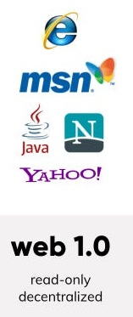
What Does Web 1.0 Mean?
Web 1.0 is the term used for the earliest version of the Internet as it emerged from its origins with Defense Advanced Research Projects Agency (DARPA) and became, for the first time, a global network representing the future of digital communications.
It describes the first “iteration” of what became a growing, evolving medium that eventually expanded into a platform with profound multi-functional uses.

Slide 12
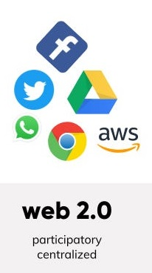
What Does Web 2.0 Mean?
Web 2.0 describes the current state of the internet, which has more user-generated content and usability for end-users compared to its earlier incarnation, Web 1.0.
In general, Web 2.0 refers to the 21st-century Internet applications that have transformed the digital era in the aftermath of the dotcom bubble.
The term Web 2.0 first came into use in 1999 as the Internet pivoted toward a system that actively engaged the user.

Slide 13
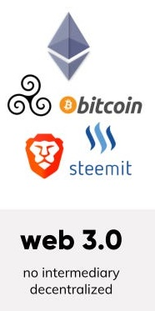
What Does Web 3.0 Mean?
It refers to the evolution of web utilization and interaction which includes altering the Web into a database, with the integration of DLT (Distributed Ledger Technology blockchain is an example) and that data can help to make Smart Contracts based on the needs of the individual.
It enables the up-gradation of the backend of the web, after a long time of focusing on the frontend (Web 2.0 has mainly been about AJAX, tagging, and other front-end user-experience innovation).
Web 3.0 is a term that is used to describe many evolutions of web usage and interaction among several paths. In this, data isn’t owned but instead shared but still is, where services show different views for the same web / the same data.

Slide 14
Differences Between the Web 1.0, Web 2.0, and Web 3.0
Web 1.0 | Web 2.0 | Web 3.0
Mostly Read-Only | Wildly Read-Write | Portable and Personal
Company Focus | Community Focus | Individual Focus
Home Pages | Blogs / Wikis | Live-streams / Waves
Owning Content | Sharing Content | Consolidating Content
WebForms | Web Applications | Smart Applications
Directories | Tagging | User behavior
Page Views | Cost Per Click | User Engagement
Data was not Focused. | Data of many was controlled by some mediatory. | Data was personalized and no use of mediatory.

Slide 15
Thank You
Image Placeholder

